Slide 1
Gangstar jam

Slide 2
Simple casual game
One hand

Slide 3

Character

Slide 4
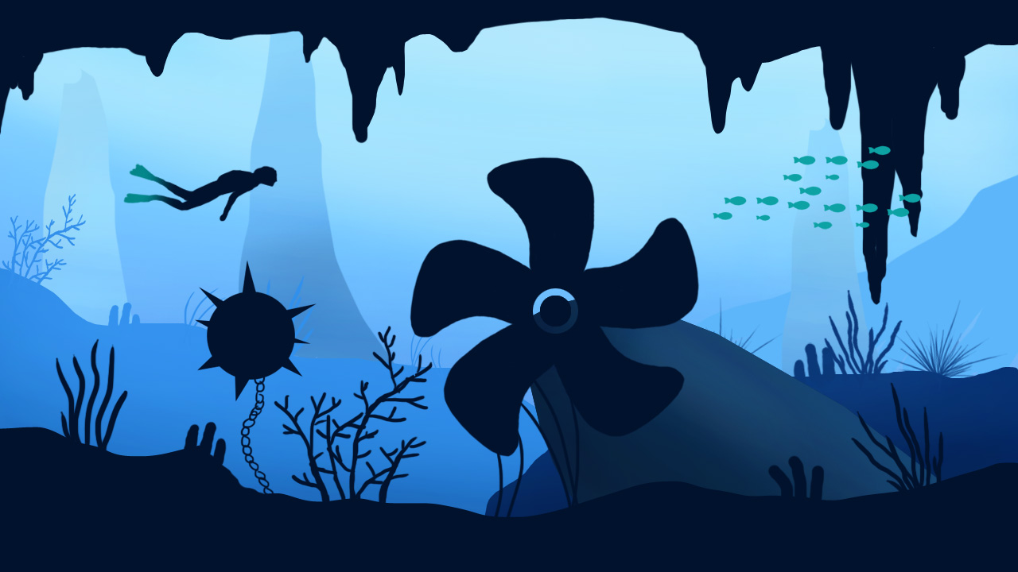
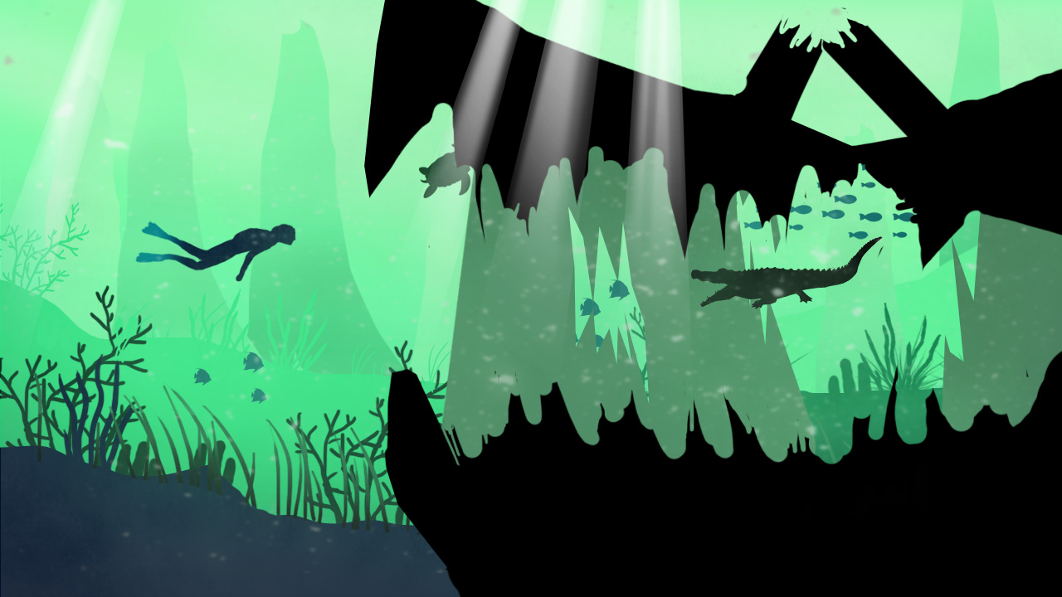
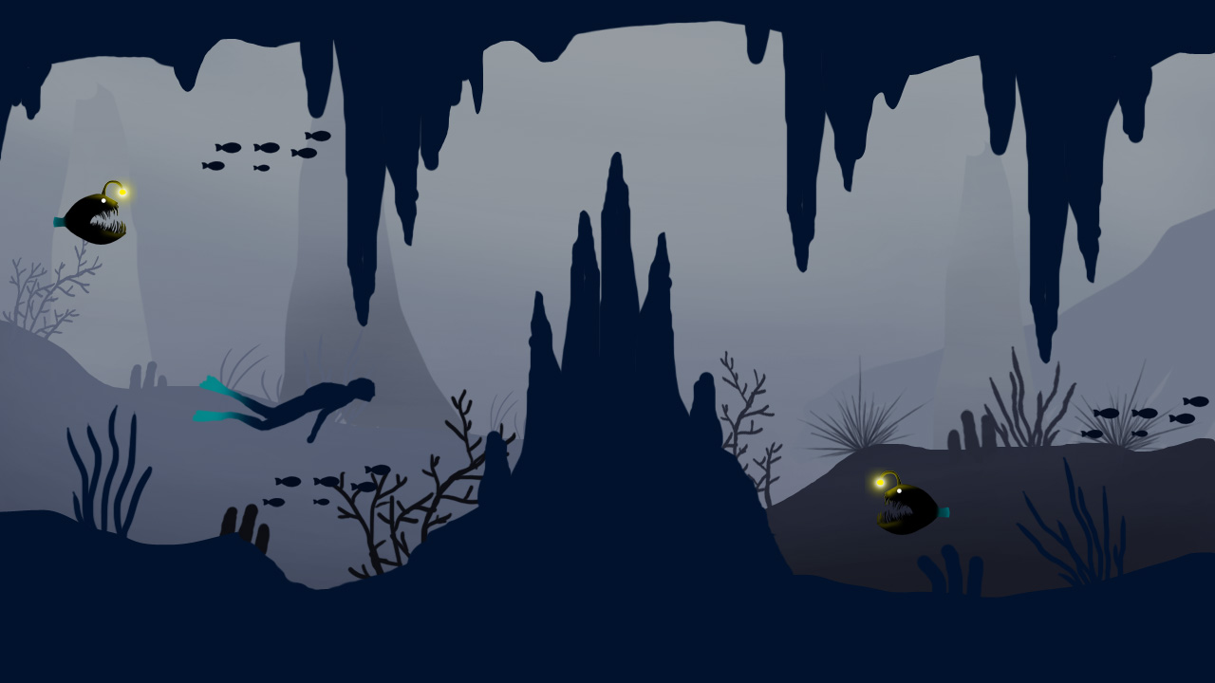
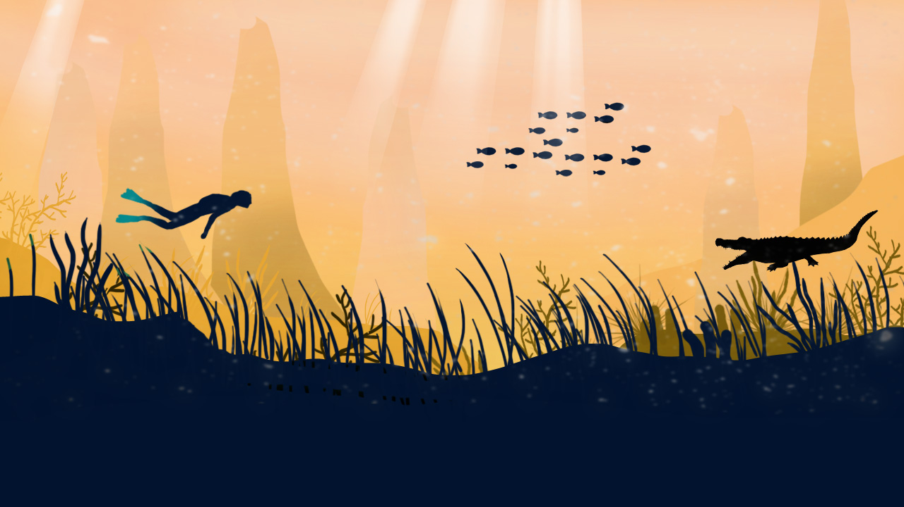
4 area to explore

Slide 5


Blue water
Obstacle:
Bomb
Submarine sunken

